Slide 1
Supervisor Glass Broadlands Presentation Supervisor Sylvia R. Glass Broad Run District Tuesday, September 10, 2024

Slide 2
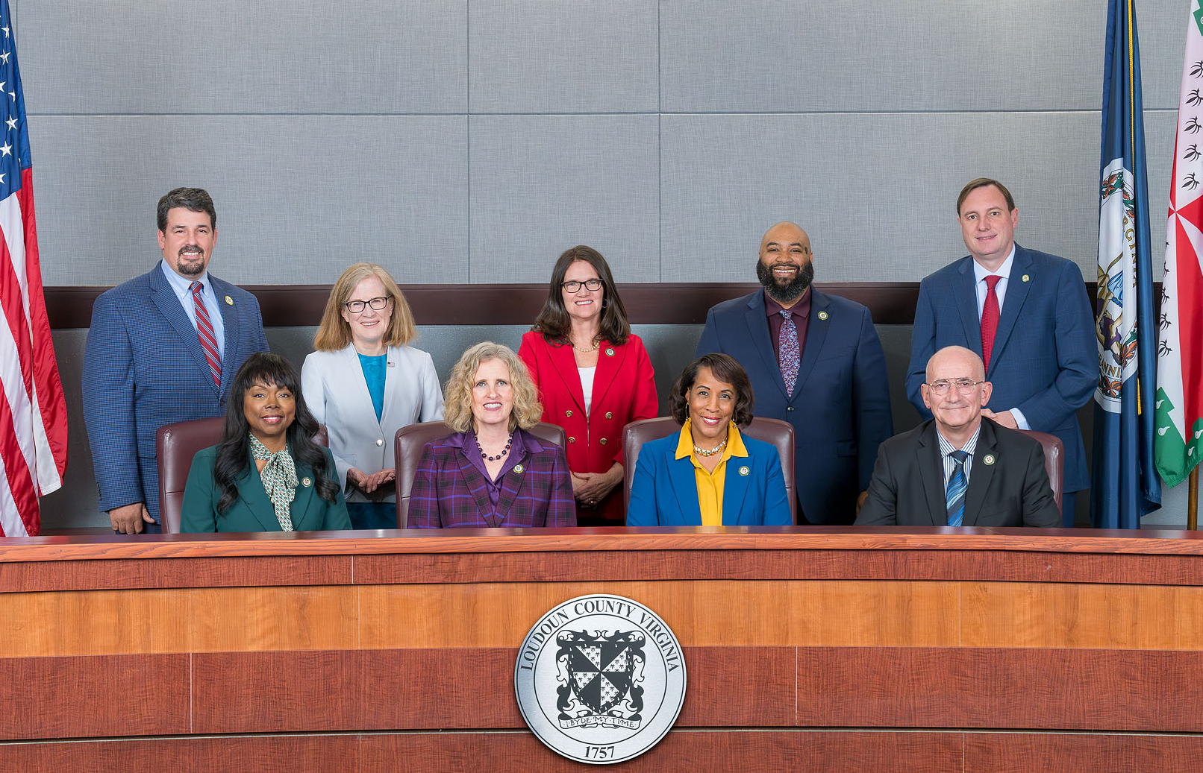
Role of a Supervisor
9 Supervisors
8 Districts of equal population
1 Countywide At-Large
4-year, concurrent terms
Vote on legislative issues and ordinance
Appropriate money
Set property tax rate
Approve development and land use projects
Represent Loudoun regionally
Sylvia.Glass@Loudoun.gov | 703-771-5088 | Loudoun.gov/BroadRun
Facebook.com/SylviaBroadRun | Twitter.com/SylviaBroadRun | Instagram.com/SylviaBroadRun

Slide 3
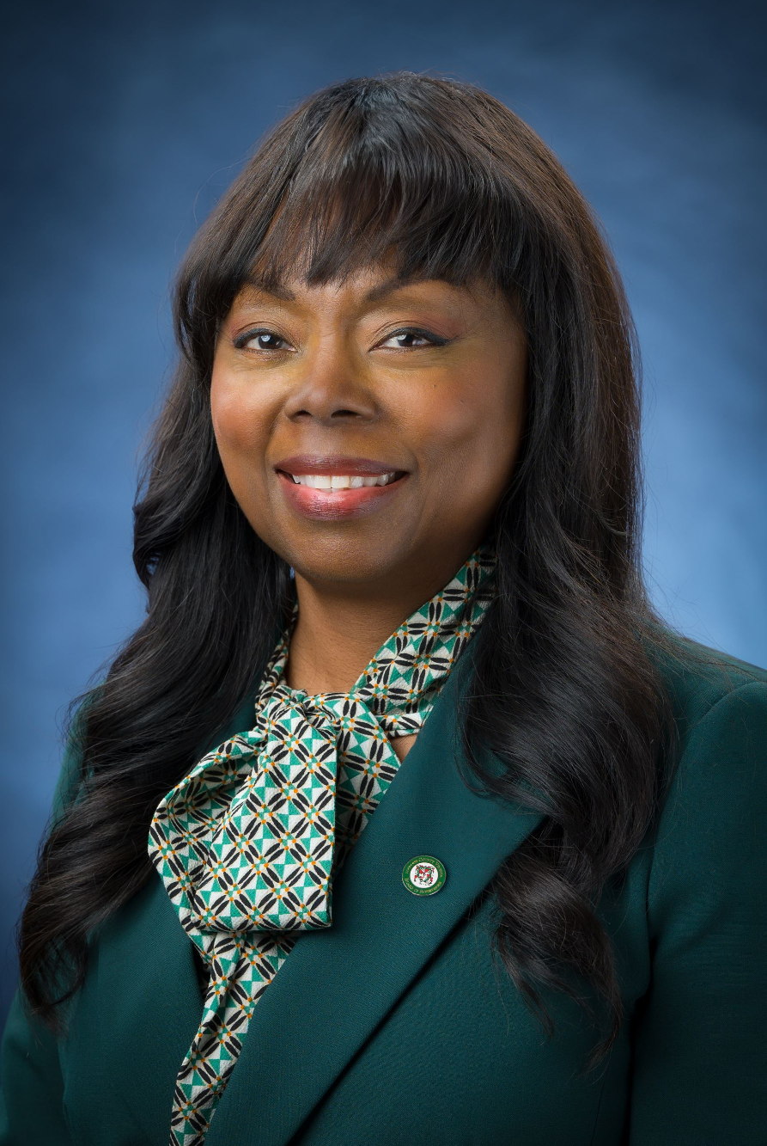
About Supervisor Glass
Resident of Ashburn Village for over 20 years
Teacher’s assistant for LCPS
Initiatives and Priorities:
Increase available affordable housing
Ensuring schools stay top-notch
Improve all aspects of transportation (vehicle, public, pedestrian, bicycle)
Sylvia.Glass@Loudoun.gov | 703-771-5088 | Loudoun.gov/BroadRun
Facebook.com/SylviaBroadRun | Twitter.com/SylviaBroadRun | Instagram.com/SylviaBroadRun

Slide 4
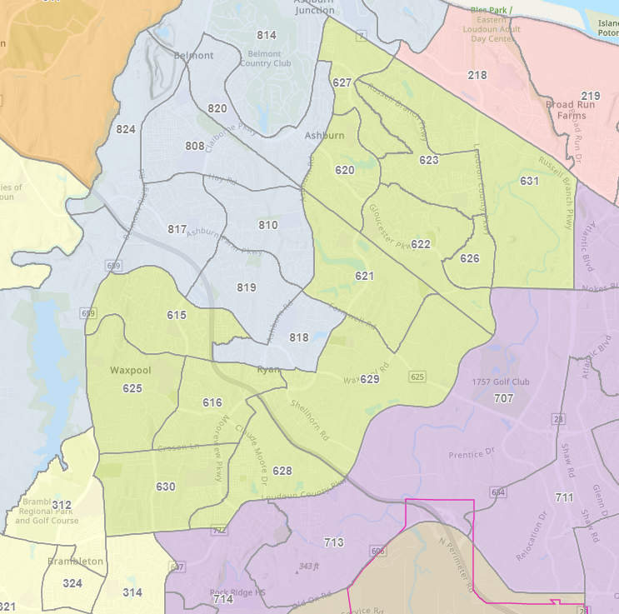
Broad Run District
Ashburn Village, Ashby Ponds, Beaumeade Circle, Broadlands, Kincora, Moorefield Station, Loudoun Station, One Loudoun, Potomac Green, Westmoore
Ashburn Metro Station
3 Sheriff Station patrol areas
5 Fire Station response areas
7 Public County Parks
Students attend 20 LCPS Schools
Broad Run Population (2020): 52,981
Sylvia.Glass@Loudoun.gov | 703-771-5088 | Loudoun.gov/BroadRun
Facebook.com/SylviaBroadRun | Twitter.com/SylviaBroadRun | Instagram.com/SylviaBroadRun

Slide 5
Fiscal Year 2025 Property Tax Rates
Board approved budget on April 2, 2024
FY 2025 runs from July 1, 2024, to June 30, 2025
$6.9 billion county and school budget
$7.4 million for affordable housing
Transportation and community projects
Croson Lane Widening from Claiborne Parkway to Old Ryan Road
Eastern Loudoun Community Arts Center added to 6-year plan
FY 2025 Real Property and Personal Property Tax Rates:
Real Property (House): $.865 per $100 value
Due to rising assessments, likely a tax increase ($200 average)
Personal Property (Car): $4.15 per $100 value
Appeal your assessment: Loudoun.gov/COR
Loudoun.gov/Budget
Sylvia.Glass@Loudoun.gov | 703-771-5088 | Loudoun.gov/BroadRun
Facebook.com/SylviaBroadRun | Twitter.com/SylviaBroadRun | Instagram.com/SylviaBroadRun

Slide 6
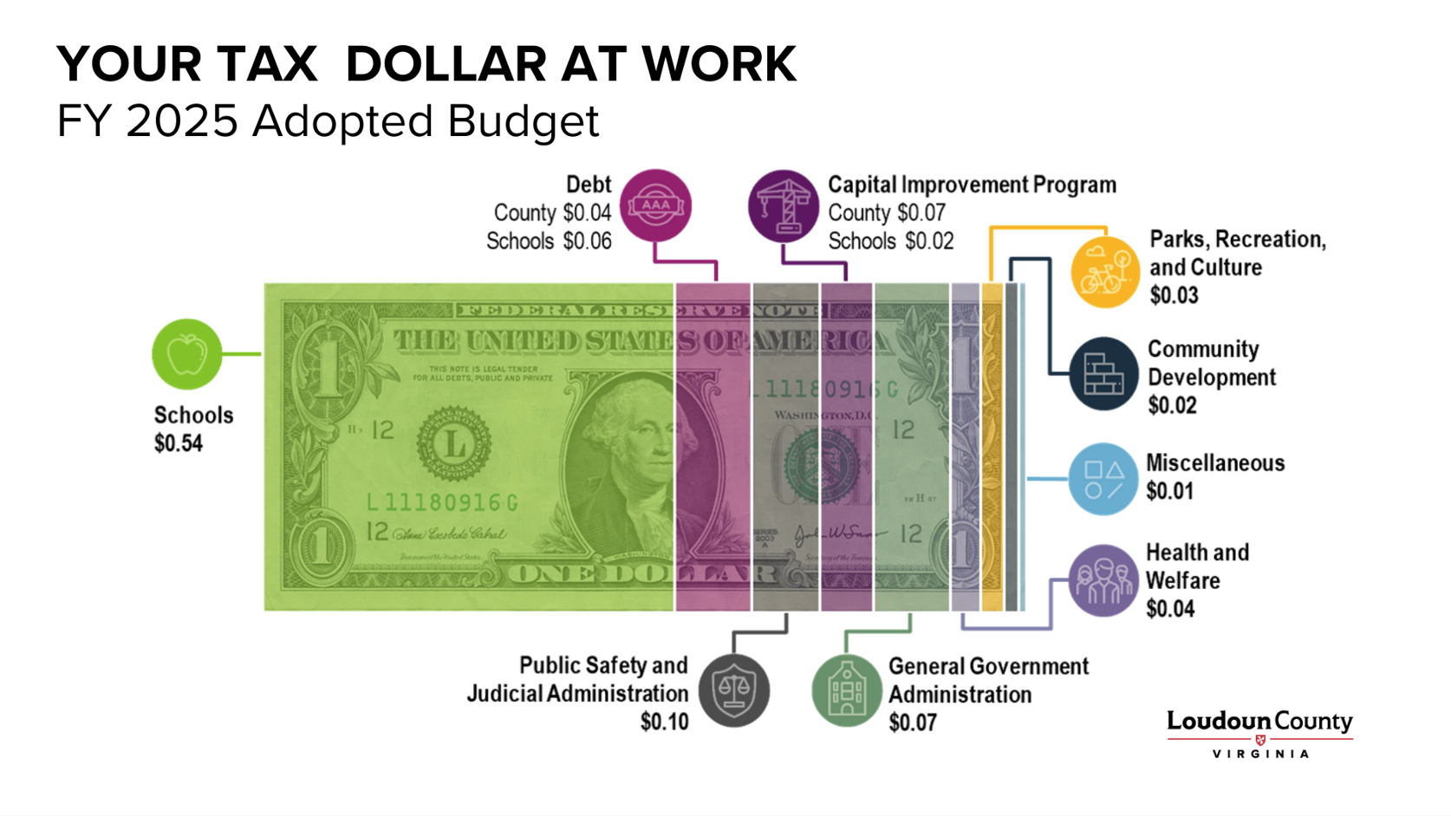
Sylvia.Glass@Loudoun.gov | 703-771-5088 | Loudoun.gov/BroadRun
Facebook.com/SylviaBroadRun | Twitter.com/SylviaBroadRun | Instagram.com/SylviaBroadRun

Slide 7
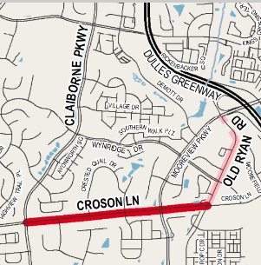
Croson Lane Widening
Claiborne Parkway to Old Ryan Road
2 lanes to 4 lanes divided
Provide missing sidewalk (north side) and shared use path (south side)
Current Status
Design plans are at 60%
Landscaping or design requests
Utility survey will begin this year
Approved in 2019
Construction projected to begin in 2026
Loudoun.gov/CrosonLaneWidening
Sylvia.Glass@Loudoun.gov | 703-771-5088 | Loudoun.gov/BroadRun
Facebook.com/SylviaBroadRun | Twitter.com/SylviaBroadRun | Instagram.com/SylviaBroadRun

Slide 8
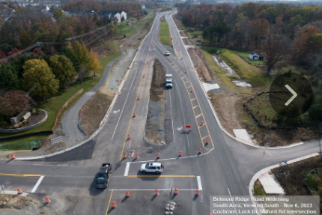
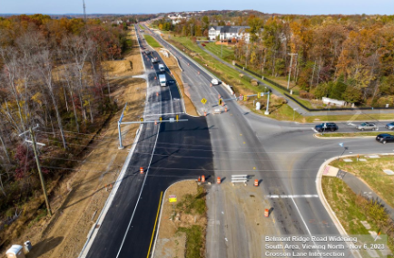
Belmont Ridge Road Widening
Widening from Truro Parish Road to Croson Lane
From two lanes to four lanes divided
Current status:
Northbound and southbound lanes now open
Pedestrian access to shared use path along Belmont Ridge Road corridor is open
Ribbon cutting to mark the end of the project will be announced soon
Potential lane closures through December
Loudoun.gov/5332
Sylvia.Glass@Loudoun.gov | 703-771-5088 | Loudoun.gov/BroadRun
Facebook.com/SylviaBroadRun | Twitter.com/SylviaBroadRun | Instagram.com/SylviaBroadRun

Slide 9
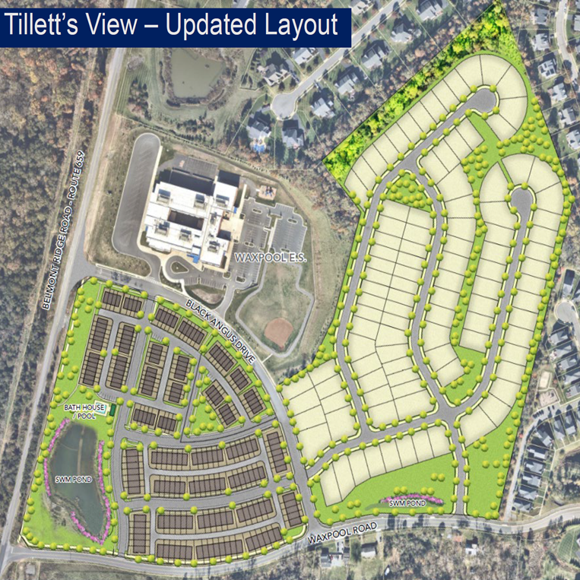
Tillett’s View
300 total units
101 Single Family, includes 13 ADUs
199 Townhouses, includes 25 ADUs
9.35 acres of open and recreation space
Pool house and clubhouse
Two open play lawns
One playground
One pickleball or volleyball court
Outdoor picnicking area, etcetera
Sidewalk on north and west sides of Waxpool Road from Munday Hill Place to Dobson Court
Signal at Waxpool Road and Truro Parish Drive
Signal study and possible installation at Black Angus Drive and Belmont Ridge Road
Sylvia.Glass@Loudoun.gov | 703-771-5088 | Loudoun.gov/BroadRun
Facebook.com/SylviaBroadRun | Twitter.com/SylviaBroadRun | Instagram.com/SylviaBroadRun

Slide 10
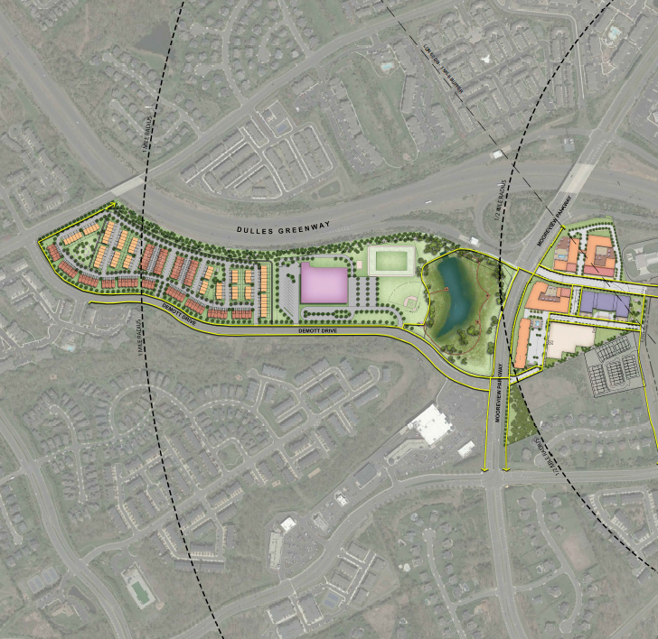
Broadlands Ashburn Metro
65 acres of land between Demott Drive, the Dulles Greenway, Waxpool Road and Old Ryan Road
843 dwelling units
Multifamily and townhouse
Up to 419,750 square feet of nonresidential development
Office and retail space
Hotel site
Educational spaces (George Mason University)
Attainable housing building at Demott Drive and Mooreview Parkway 100% pre-leased
Sylvia.Glass@Loudoun.gov | 703-771-5088 | Loudoun.gov/BroadRun
Facebook.com/SylviaBroadRun | Twitter.com/SylviaBroadRun | Instagram.com/SylviaBroadRun

Slide 11
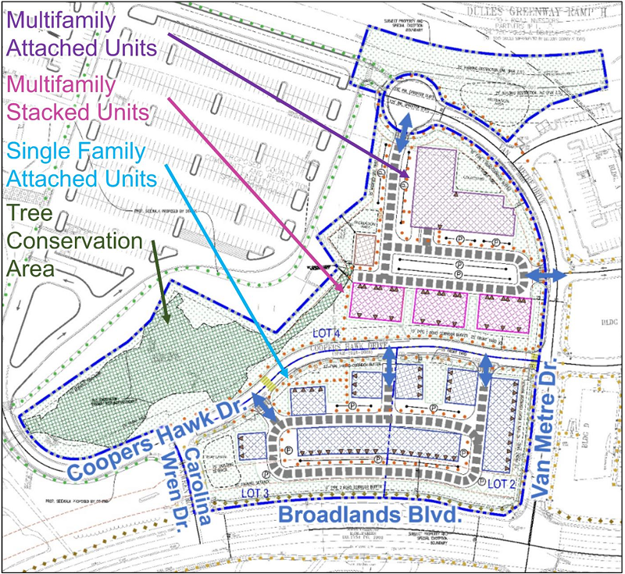
Broadlands Section 104
Vacant land at Broadlands Boulevard and Van Metro Drive
136 housing units
45 townhomes
27 condos
64 apartments
30 units will be attainable housing units
Developer will install sidewalks to connect to the future Ashburn Recreation and Community Center
Sylvia.Glass@Loudoun.gov | 703-771-5088 | Loudoun.gov/BroadRun
Facebook.com/SylviaBroadRun | Twitter.com/SylviaBroadRun | Instagram.com/SylviaBroadRun
Sylvia.Glass@Loudoun.gov | 703-771-5088 | Loudoun.gov/BroadRun
Facebook.com/SylviaBroadRun | Twitter.com/SylviaBroadRun | Instagram.com/SylviaBroadRun

Slide 12
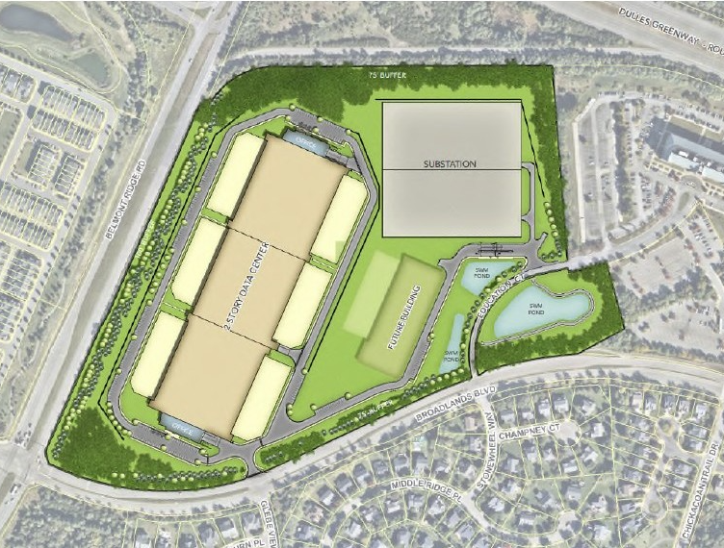
Broadlands CyrusOne
Construction of 1 million square foot data center
50 acres of vacant land located between Belmont Ridge Road, Broadlands Boulevard, Education Court, and the Dulles Greenway
By-right data center
Did not need Board approval
Working with CyrusOne and the Broadlands HOA to discuss landscaping and architectural enhancements
Sylvia.Glass@Loudoun.gov | 703-771-5088 | Loudoun.gov/BroadRun
Facebook.com/SylviaBroadRun | Twitter.com/SylviaBroadRun | Instagram.com/SylviaBroadRun

Slide 13
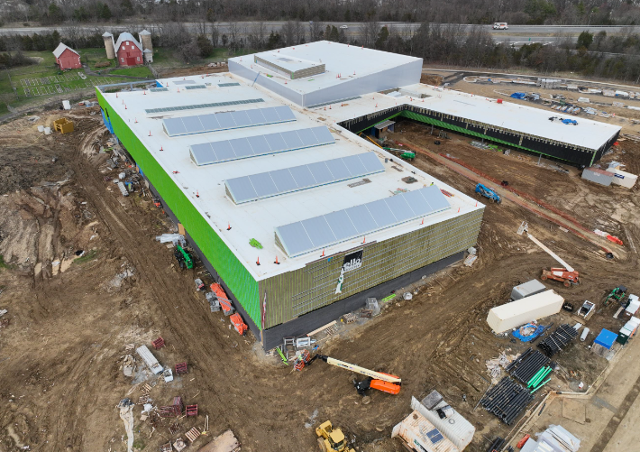
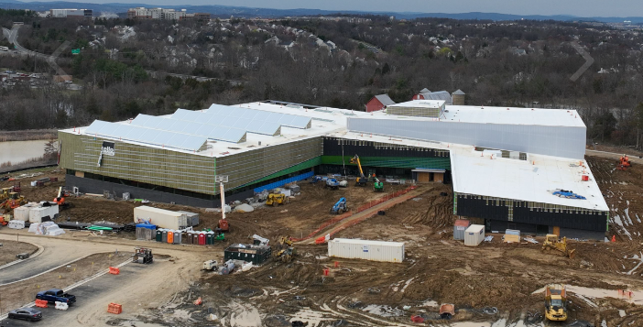
Ashburn Recreation and Community Center
Construction of 117,000-square-foot
Broadlands Boulevard west of the intersection with Claiborne Parkway
Features:
Two pools, gymnasium, classrooms, running track
Estimated to open for use the summer of 2025
Loudoun.gov/5261
Sylvia.Glass@Loudoun.gov | 703-771-5088 | Loudoun.gov/BroadRun
Facebook.com/SylviaBroadRun | Twitter.com/SylviaBroadRun | Instagram.com/SylviaBroadRun

Slide 14
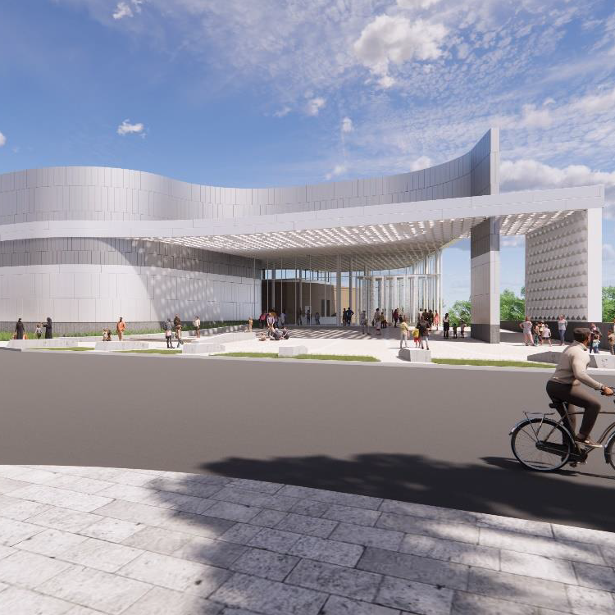
Northern Virginia Science Center
Approximately 5-acre site
On Knowledge Drive backing to the Broad Run at the Kincora Development
95,000 square feet
Loudoun County contributed $19 million
Additional contributions
Commonwealth of Virginia
Private
Land donated by Kincora
Groundbreaking to begin this fall
Novasci.org
Sylvia.Glass@Loudoun.gov | 703-771-5088 | Loudoun.gov/BroadRun
Facebook.com/SylviaBroadRun | Twitter.com/SylviaBroadRun | Instagram.com/SylviaBroadRun

Slide 15
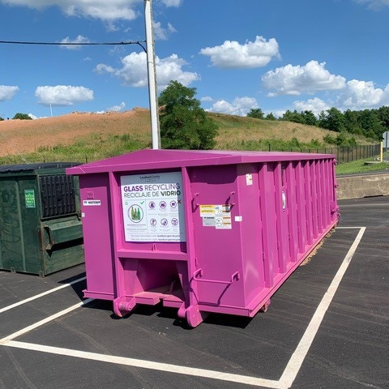
Glass Recycling
Supervisor Glass Initiative
Open a county glass recycling center in Ashburn
One Loudoun Park and Ride
20360 Savin Hill Drive
Behind Ashburn Sheriff Station
Two glass-only recycling roll-off containers
Ribbon cutting was today and is now open
Loudoun.gov/Recycling
Sylvia.Glass@Loudoun.gov | 703-771-5088 | Loudoun.gov/BroadRun
Facebook.com/SylviaBroadRun | Twitter.com/SylviaBroadRun | Instagram.com/SylviaBroadRun

Slide 16
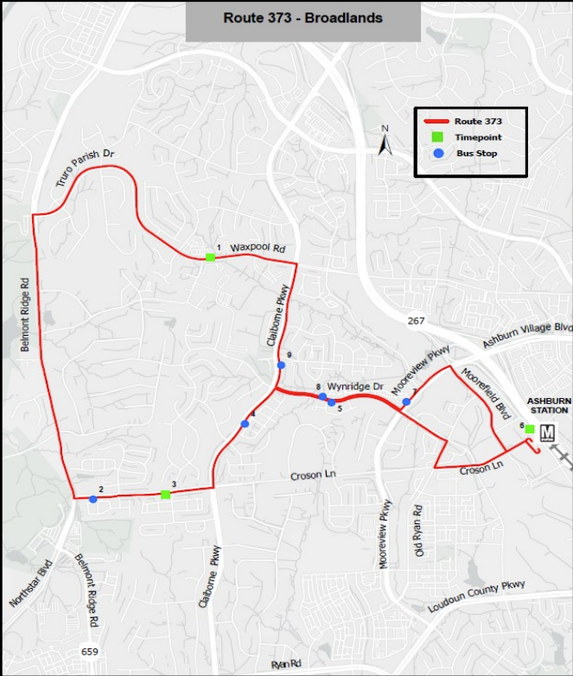
Buses to Metro
Loudoun County Metro Stations: Ashburn, Loudoun Gateway, Dulles Airport, and Innovation Station Center (across County line)
Development around the Metro will be dense and transit-oriented
Loudoun Transit offers bus service to Metro
Broadlands is served by stops on the Broadlands Route 373 as well as the Ashburn Farm Routes 343 and 344
Loudoun.gov/SilverLineBusRoutes
Sylvia.Glass@Loudoun.gov | 703-771-5088 | Loudoun.gov/BroadRun
Facebook.com/SylviaBroadRun | Twitter.com/SylviaBroadRun | Instagram.com/SylviaBroadRun

Slide 17
Upcoming County Meetings
BOS Business Meetings:
1st and 3rd Tuesday of every month at 5pm
Next Meetings: September 17 and October 1 at 5pm
BOS Public Hearing:
2nd Wednesday of every month at 6pm
Next Meeting: September 11 at 6pm
Finance/Government Operations and Economic Development Committee Meeting:
2nd Tuesday of every month at 6pm
Next meeting: September 10 at 6pm
Joint BOS & School Board Committee Meeting:
Meets quarterly
Next meeting: October 7 at 4pm
Transportation & Land Use Committee Meeting:
3rd Wednesday of every month at 6pm
Next meeting: September 18 at 5pm
View all meeting information at: Loudoun.gov/Meetings
Through the above link, meetings can be watched in real time and all past meeting videos can be viewed
Upcoming and past meeting agendas, and supporting documents, can be viewed by clicking “Agenda” next to the associated meeting
Public comment can occur remotely:
Anyone who wants to participate remotely can call 703-777-0200 by noon on the meeting day
Instructions on remote participation will be provided to those who sign up ahead of time
Speakers will be able to contribute through their computer or phone
Sylvia.Glass@Loudoun.gov | 703-771-5088 | Loudoun.gov/BroadRun
Facebook.com/SylviaBroadRun | Twitter.com/SylviaBroadRun | Instagram.com/SylviaBroadRun

Slide 18
Questions? Sylvia.Glass@Loudoun.gov | 703-771-5088 Loudoun.gov/BroadRun | Facebook.com/SylviaBroadRun Twitter.com/SylviaBroadRun | Instagram.com/SylviaBroadRun
Sylvia.Glass@Loudoun.gov | 703-771-5088 | Loudoun.gov/BroadRun
Facebook.com/SylviaBroadRun | Twitter.com/SylviaBroadRun | Instagram.com/SylviaBroadRun

